Slide 1

Zindi mentorship programme
Final presentation
Detection of violenced and unviolenced women
Mentor:
Ms.Grace Omojola
Mentees:
Sahar Ben Mabrouk
Tosin Akintibu
Damaris Ndjebayi
Nancy Boakye

Slide 2
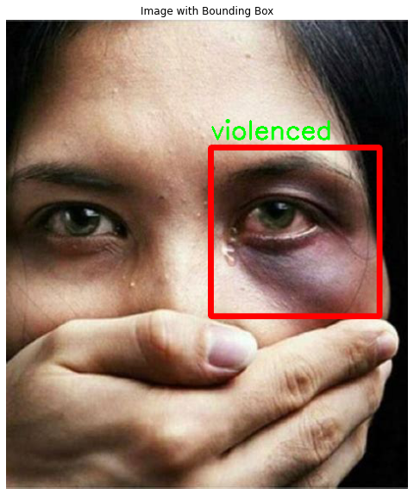
Concept of the idea :
Many women who are victims of gender-based violence tend to remain silent or hide the scars
Building an Object detection Model that can identify the hurted part on the face of violence’s victim
Generating a bounding box around the hurted part
Constructing a dataset
Labelling the images with bounding boxes
Notes:
The idea is oriented to gender-based violence , in fact it’s about building a model that detect the face of violenced woman and draw a bounding box around the hurted part

Slide 3
Steps of the project:
Scrapping images
labelling
Choosing the model
Notes:
The idea is oriented to gender based violence , in fact it’s about building a model that detect the face of violenced woman and draw a bounding box around the hurted part

Slide 4
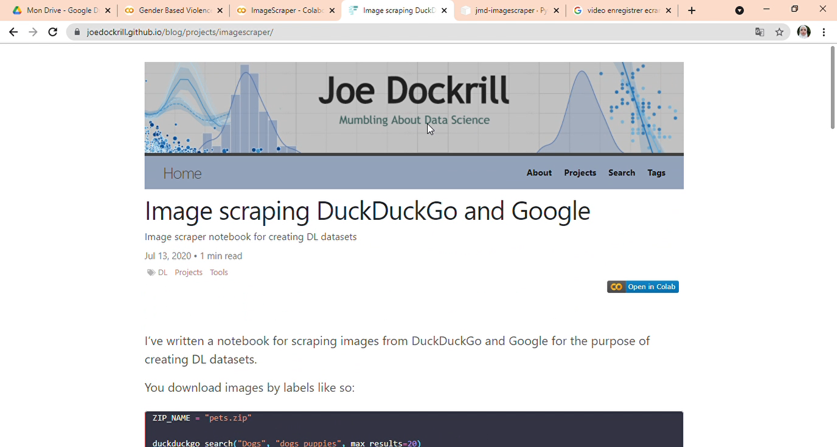
Steps of the project:
Scrapping the images
Scrapping the required images using DuckDuck Go image scrapper library developped by Joe Dockrill

Slide 5

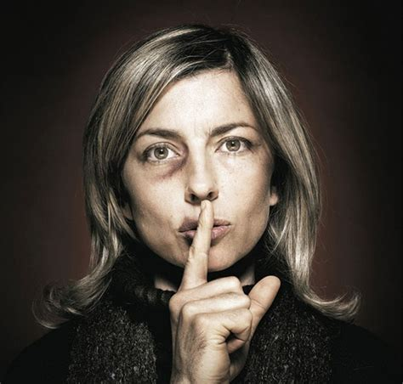
Steps of the project:
Scrapping the images
unviolenced
violenced

Slide 6
Steps of the project:
Scrapping the images

Slide 7
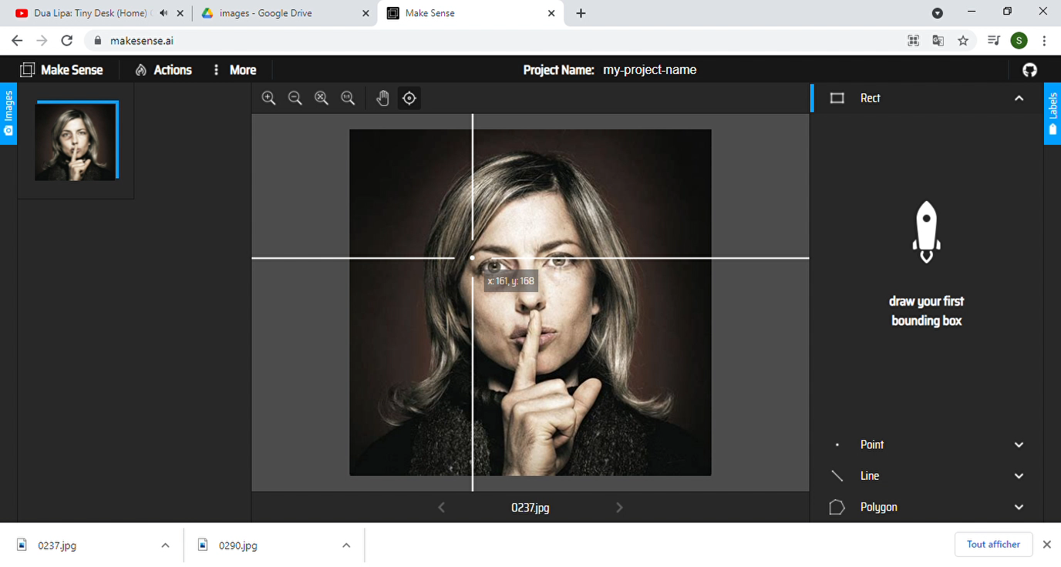
Steps of the project:
Labelling the images
Labelling the images with bounding boxes
Using the online annotation website https://www.makesense.ai/

Slide 8
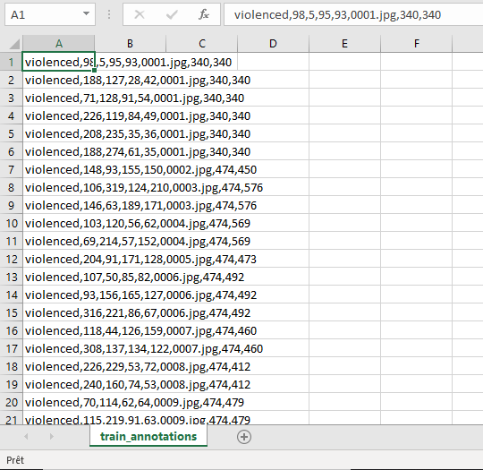
Steps of the project:
Labelling the images
Exported annotation’s files are in the following format: class,Xmin,Ymin,w,h,img_name,W,H
It should be converted to this format: img_id,Xmin,Xmax,Ymin,Ymax,Class

Slide 9
Steps of the project:
Labelling the images

Slide 10
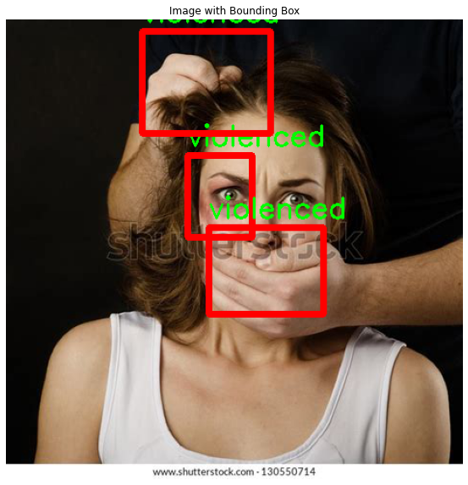
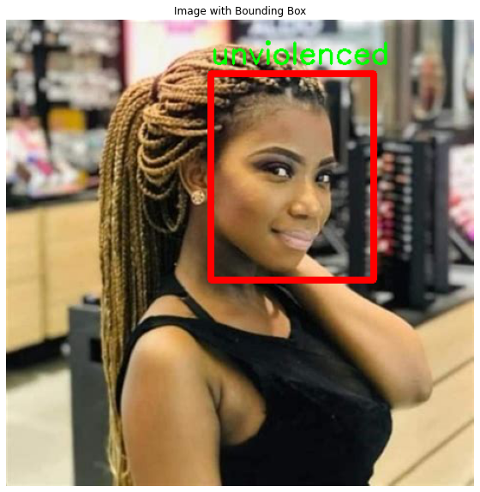
Steps of the project:
Ground truths visualisation

Slide 11
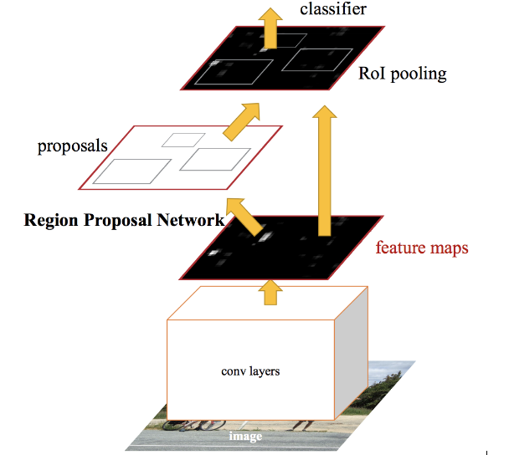
Steps of the project:
Choosing the model
Faster RCNN
It’s an accurate object detection model based on region proposal network that generates region of interests in an image, developped by Shaoqing Ren et al,
YOLO
RetinaNet
Notes:
The idea is oriented to gender based violence , in fact it’s about building a model that detect the face of violenced woman and draw a bounding box around the hurted part

Slide 12
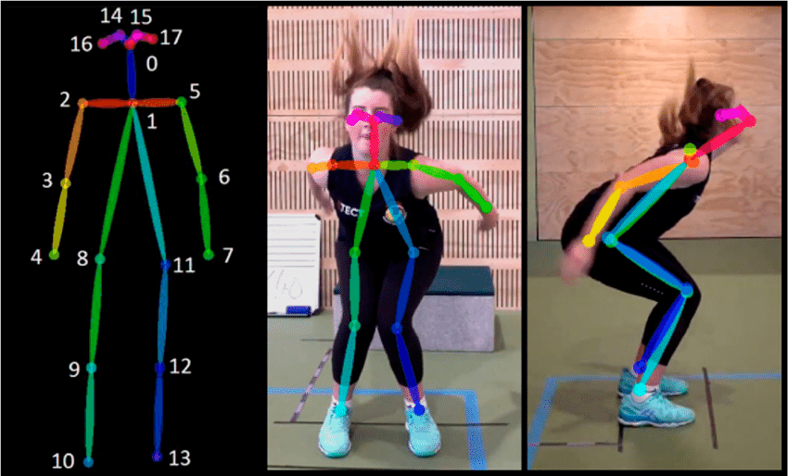
What can we add to the project:
More clean and less noisy images to the dataset
Keypoint annotations in order to make pose estimation task

Slide 13
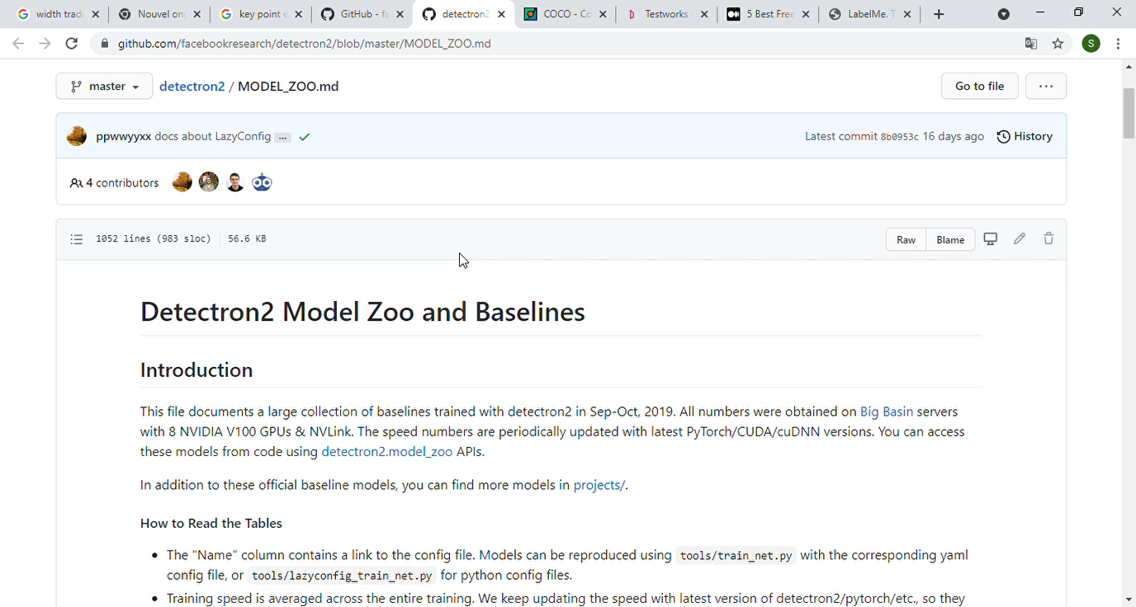
What can we add to the project:
Using facebook detectron2 model for pose estimation: region based CNN backboned with resnet and feature pyramid network fpn

Slide 14
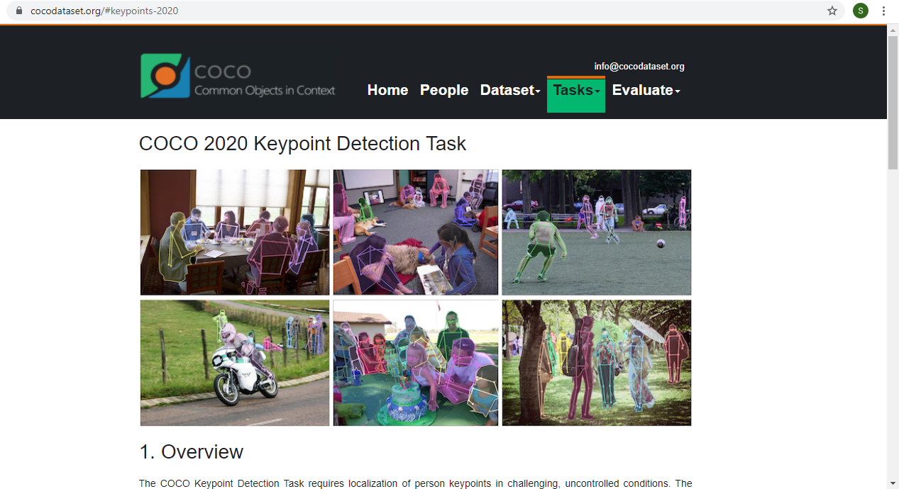
What can we add to the project:
Using transfer learning: a pretrained model on coco dataset for keypoint detection

Slide 15
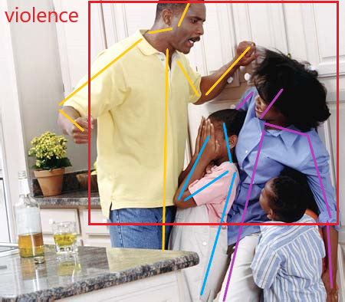
What can we add to the project:
Train the model to detect if a person is facing violence by estimating the pose
classify the victim (woman or man) and the agressor

Slide 16
The end..
Thanks for your attention
Notes:
The idea is oriented to gender based violence , in fact it’s about building a model that detect the face of violenced woman and draw a bounding box around the hurted part

